Slide 1
Lateralized vs. classic style reverse shoulder arthroplasty
Tim Schneller, 13.09.2023

Slide 2
Outline
Introduction
Shoulder Anatomy
Evolution of Shoulder Arthroplasty
Methods
Results
Discussion

Slide 3
Introduction – Shoulder Anatomy
Complex anatomy of the shoulder joint
Allows huge range of motion in all directions
Susceptible to injury and degenerative disorders
High dependency for daily living
→ Big need for adequate treatment

Slide 4
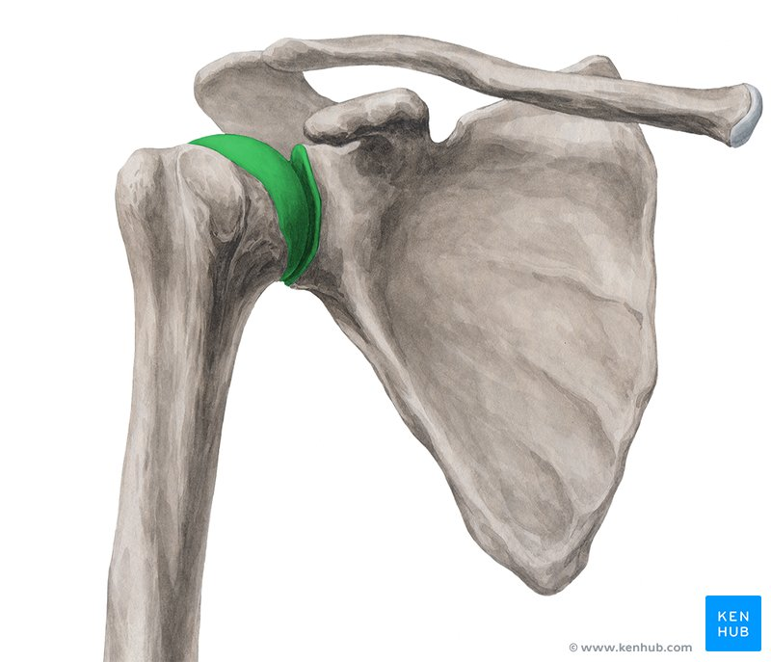
Introduction – Shoulder Anatomy
Glenoid
Humeral head
Scapula

Slide 5
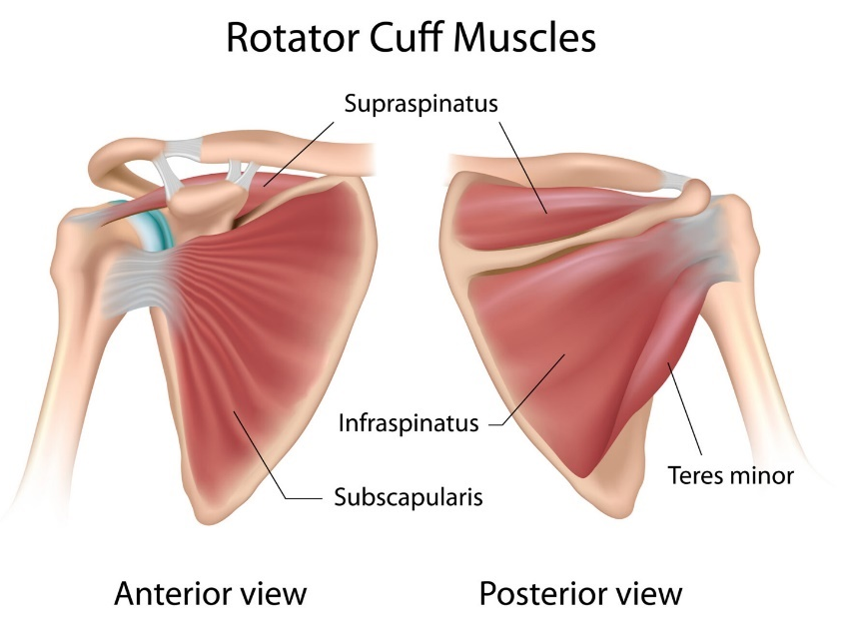
Introduction – Shoulder Anatomy

Slide 6
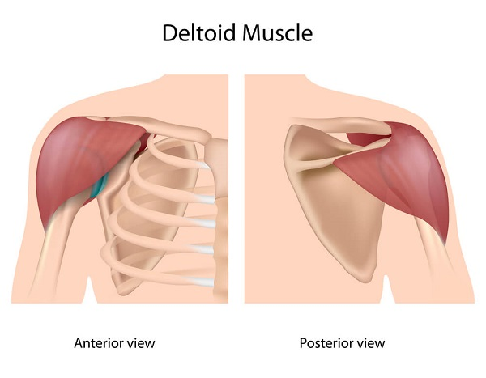
Introduction – Shoulder Anatomy

Slide 7
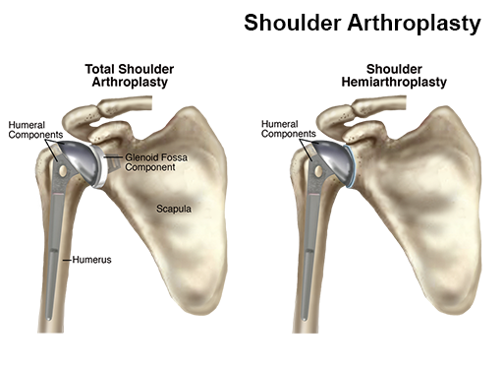
Introduction – Evolution of Shoulder Arthroplasty
Center of Rotation

Slide 8
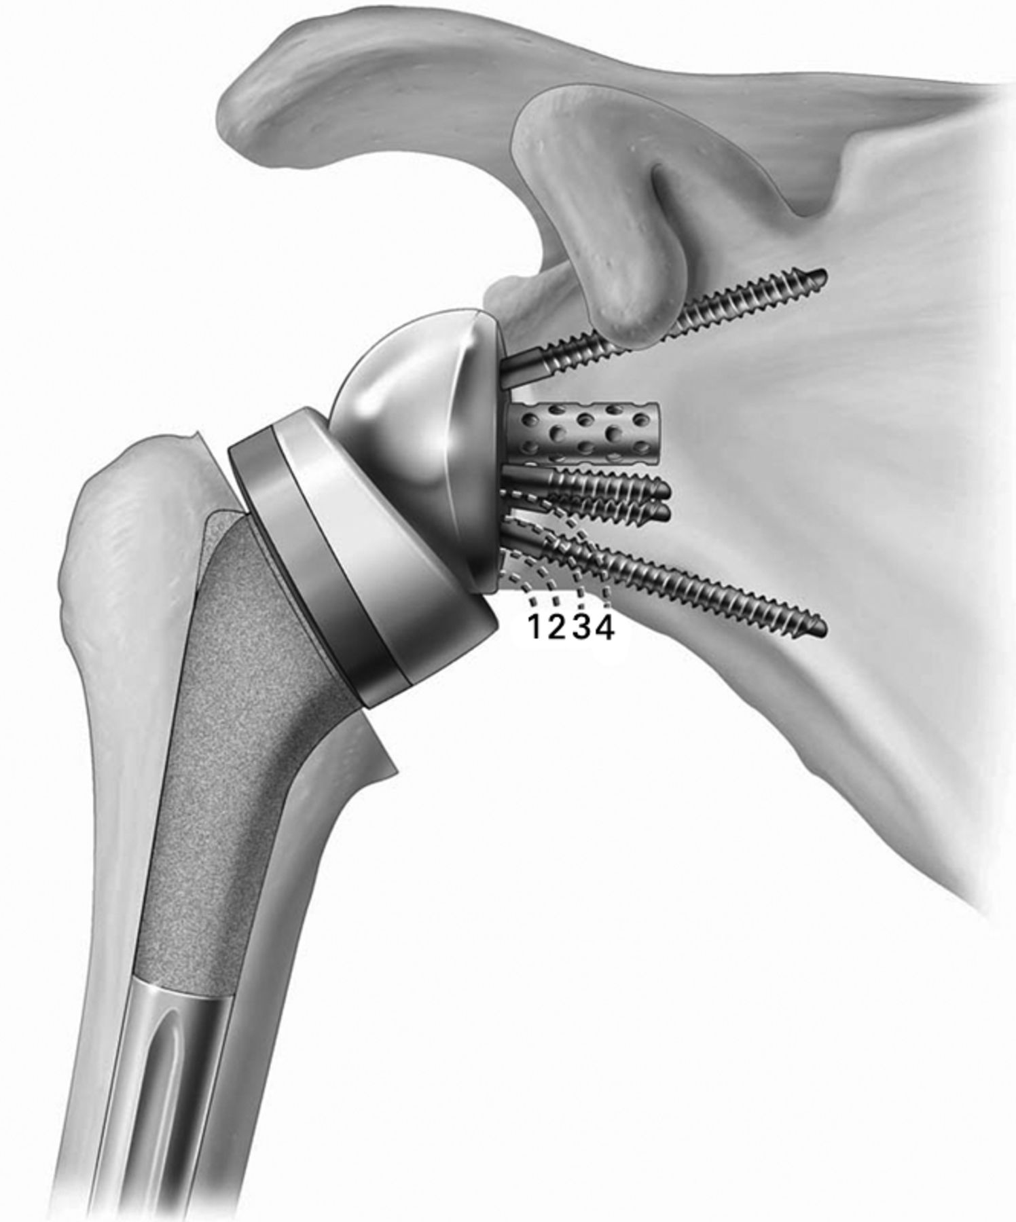
Introduction – Evolution of Shoulder Arthroplasty
Reverse (Total) Shoulder Arthroplasty
Inverted configuration of components
Medialization of Center of Rotation
+ bigger force output deltoid muscle
- scapular notching
Center of Rotation rTSA
Center of Rotation TSA

Slide 9
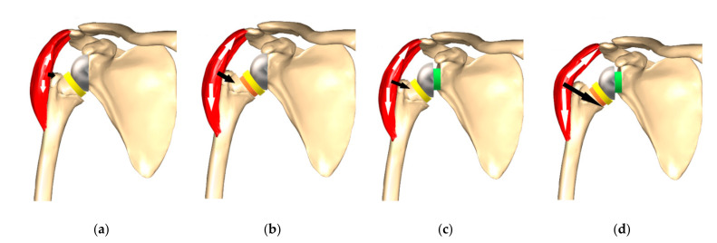
Introduction – Evolution of Shoulder Arthroplasty
Lateralization
Reduced rate of notching
Increased deltoid tension
→ more deltoid force
Classic: no offset
Lateralized: glenoidal offset

Slide 10
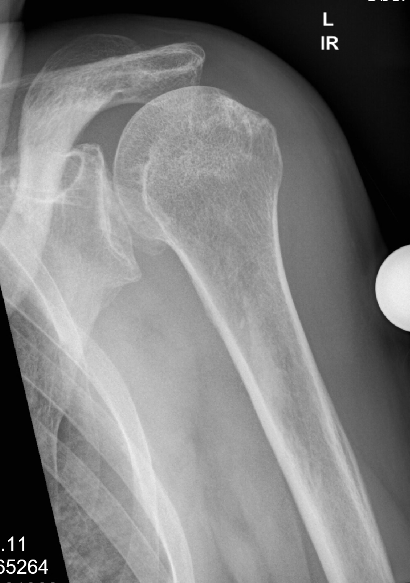
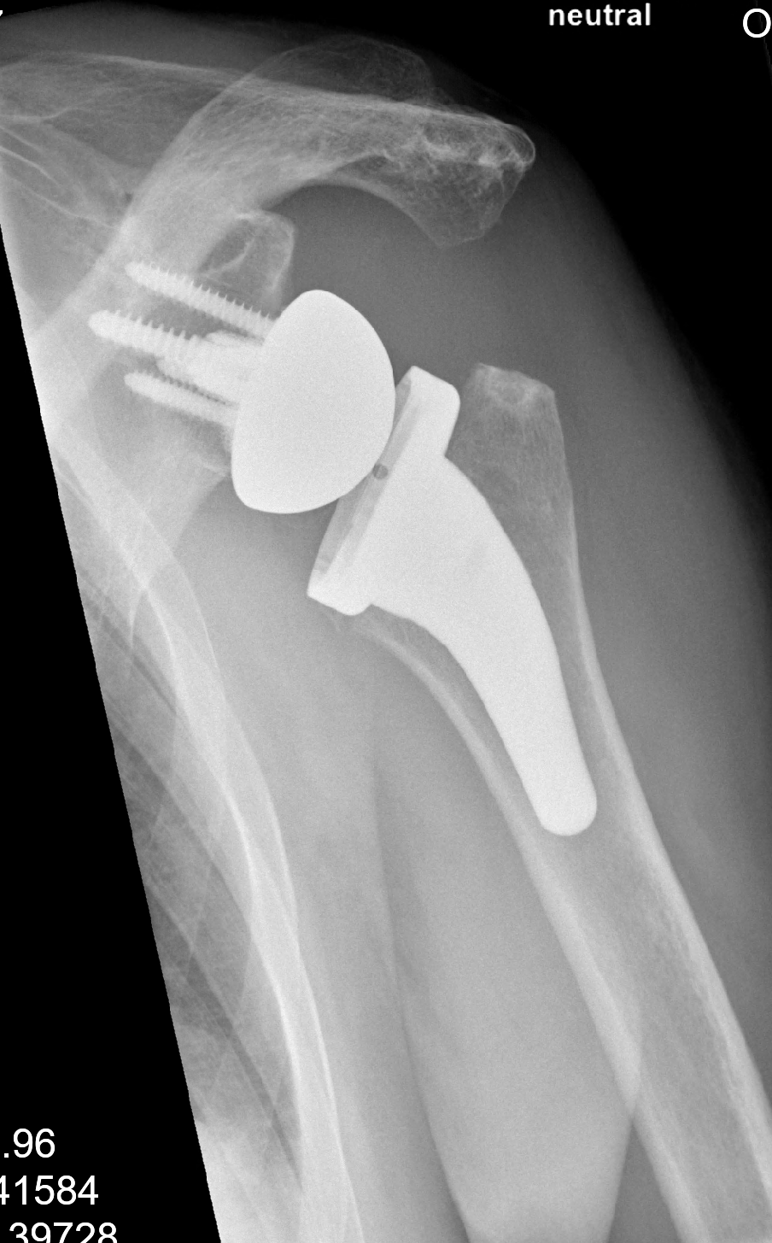
Center of Rotation

Slide 11
Methods
Data Source: Shoulder arthroplasty registry at Schulthess Clinic
Inclusion criteria:
Implantation of reverse shoulder arthroplasty, model Aequalis
2 years postop follow up data available
Exclusion criteria:
Revision operations
Groups
Classic configuration without lateralization
Lateralized Glenoid

Slide 12
Methods
Constant Score (composite objective parameter, 0-100)
Abduction strength
ROM
Subjective Shoulder Value (patient reported outcome, 0-100)
Scapular Notching grade (objective parameter, 0-4)
0 = no sign of notching
1 = notch limited to the scapular pillar
2 = notch reaching the inferior screw of the base plate
3 = notch extending beyond the inferior screw
4 = notch reaching the base plate central peg/screw

Slide 13
Methods
Pearson D’Agostino Test for normality
Unpaired t-test for normal distributed CS and SSV (Welsch’s Correction if unequal SD)
Mann-Whitney U Test for not normally distributed CS and SSV
Chi² Test for categorical data (notching)
Level of Confidence: 95% → α = 0.05
Libraries: pandas, numpy, matplotlib, scipy

Slide 14
Results
 | Classic | Lateralized
Gender male female | 151 (38%) 251 (62%) | 64 (42%) 89 (58%)
Age at surgery | 75 [41,95] | 75 [42,95]
BMI at surgery | 27.2 ± 5.0 | 26.8 ± 5.0
ASA Classification ASA 1: a normal, healthy patient ASA 2: a patient with mild systemic disease ASA 3: a patient with severe systemic disease ASA 4: a patient with severe systemic disease that is a constant threat to life | 7 (2%) 209 (52%) 182 (45%) 4 (1%) | 4 (3%) 88 (58%) 60 (39%) 1 (<1%)
Diagnosis Cuff Tear Arthropathy (CTA) Primary Osteoarthrits (OA) Fracture Sequelae Acute Fracture Primary Humeral Head Necrosis Rheumatoid Arthritis Other Osteoarthritis due to Instability | 203 (54%) 90 (24%) 44 (12%) 16 (4%) 12 (3%) 5 (1%) 4 (1%) 2 (<1%) | 78 (56%) 42 (30%) 14 (10%) 2 (1%) 3 (2%) - - -
Note. N=555. Classic group (n=402), Lateralized group (n=153)

Slide 15
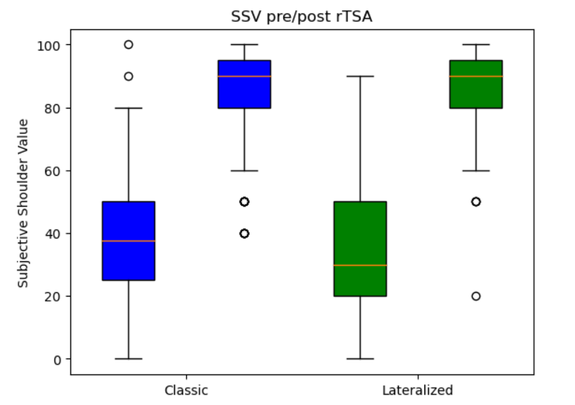
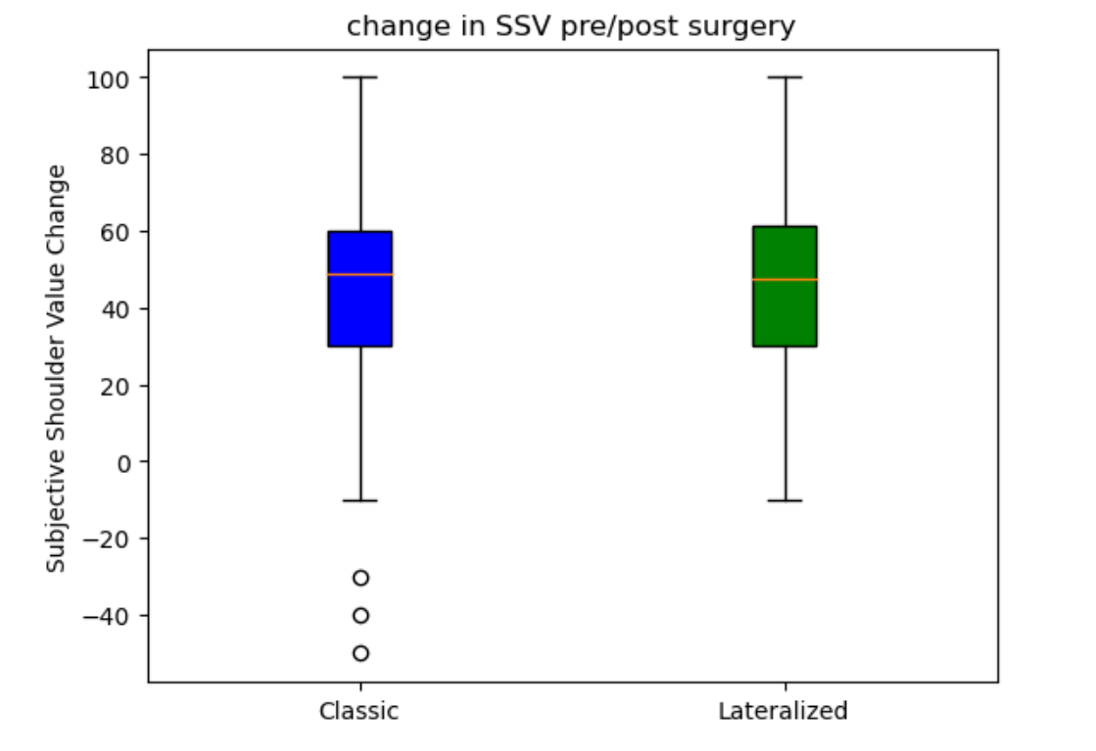
Results
p=0.93

Slide 16
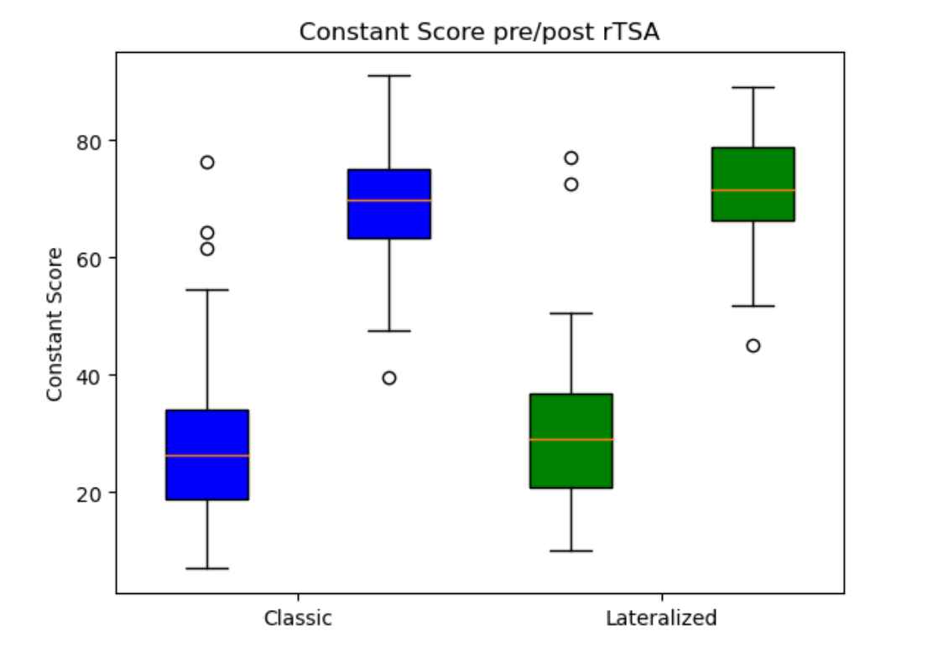
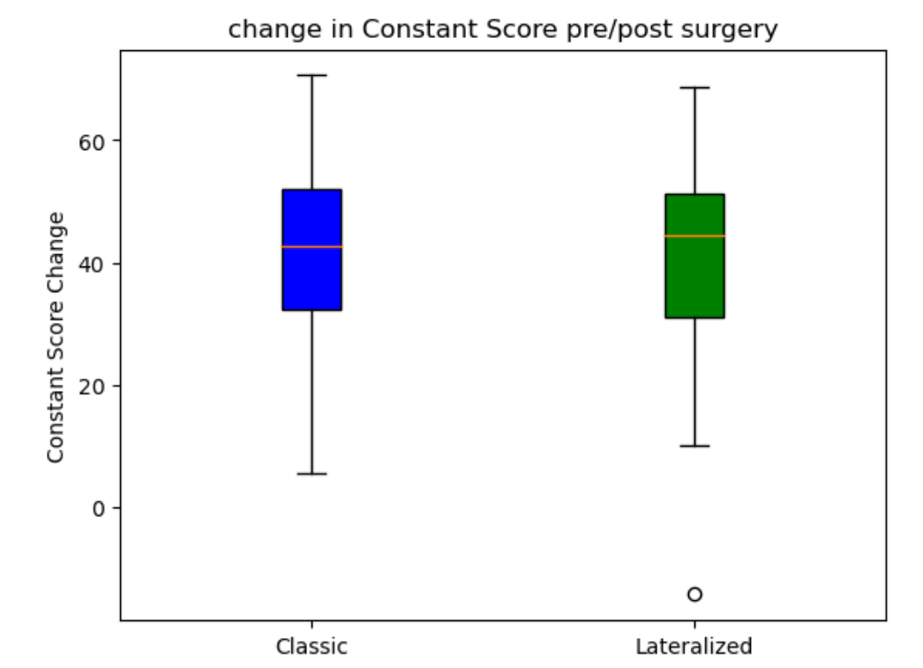
Results
p=0.88

Slide 17
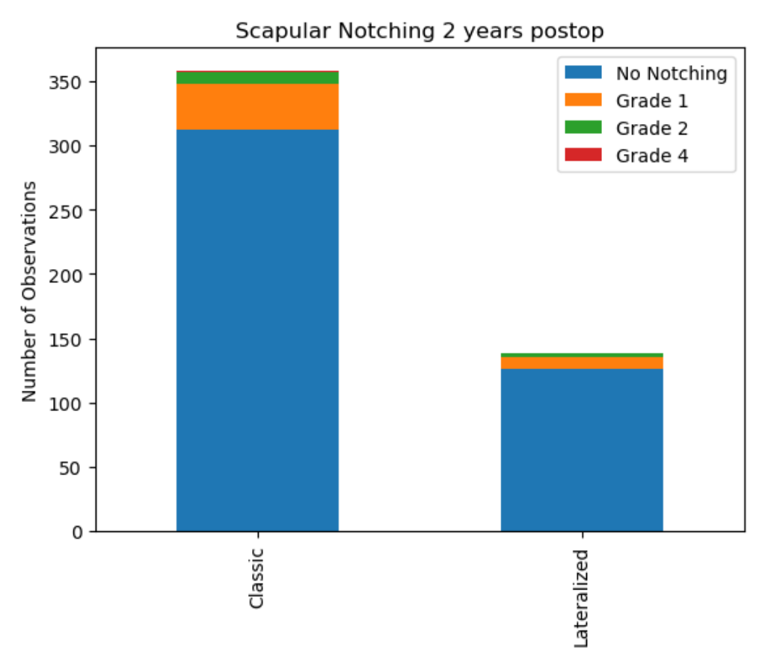
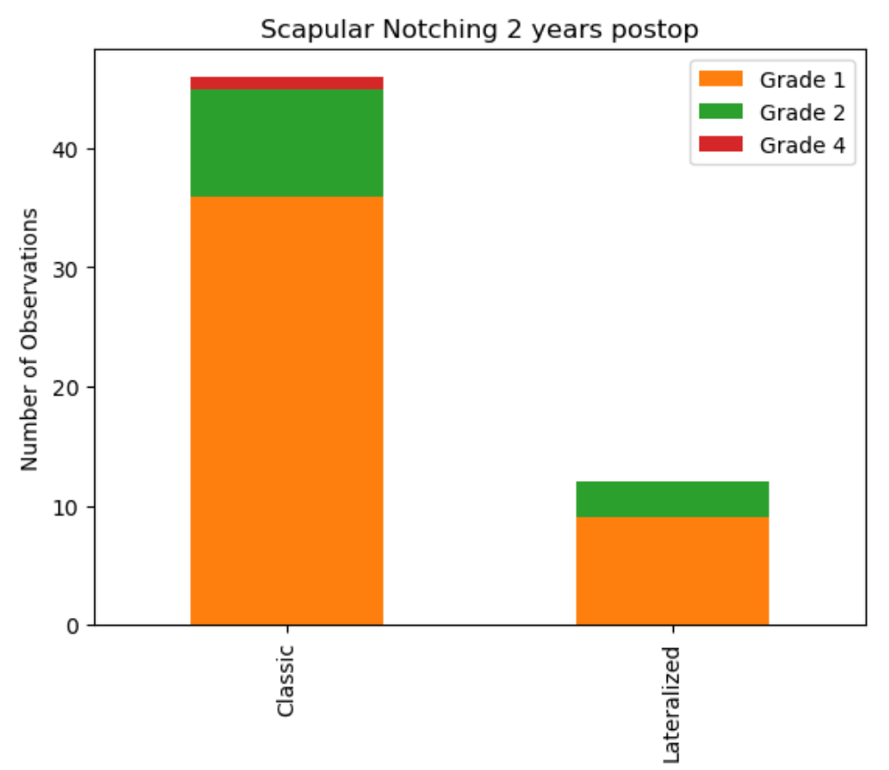
Results
p=0.25

Slide 18
Results
No significant differences for subgroup analysis either..
male classic vs. male lateralized
BMI>25 classic vs. BMI>25 lateralized
ASA 3 + 4 classic vs. ASA 3 + 4 lateralized
CTA classic vs. CTA lateralized
etc.
p>0.05 for all subgroup comparisons

Slide 19
Discussion
No observed statistical difference between the studied groups classic and lateralized reverse shoulder arthroplasty
No difference in subgroups either
Possibly trend towards lower rates of notching in lateralized glenoids
With the data at hand, no advantage of incorporating lateralization in reverse shoulder arthroplasty could be detected

Slide 20
Thank you for your attention! Questions?

Slide 21
References
Literature:
Grammont reverse prosthesis: design, rationale, and biomechanics - PubMed (nih.gov)
Etude et réalisation d'une nouvelle prothèse d'épaule | Semantic Scholar
Lateralization in Reverse Shoulder Arthroplasty - PMC (nih.gov)
Figures:
Glenohumeral (Shoulder) joint: Bones, movements, muscles | Kenhub
Rotator Cuff Tears Anatomy | Town Center Orthopaedics
Total Shoulder Arthroplasty vs Hemiarthroplasty for Rheumatoid Arthritis of the Shoulder | Doctor Shoulder
Scapular notching and osteophyte formation after reverse shoulder replacement | Bone & Joint (boneandjoint.org.uk)

